Slide 1
FAMOUS PEOPLE

Slide 2
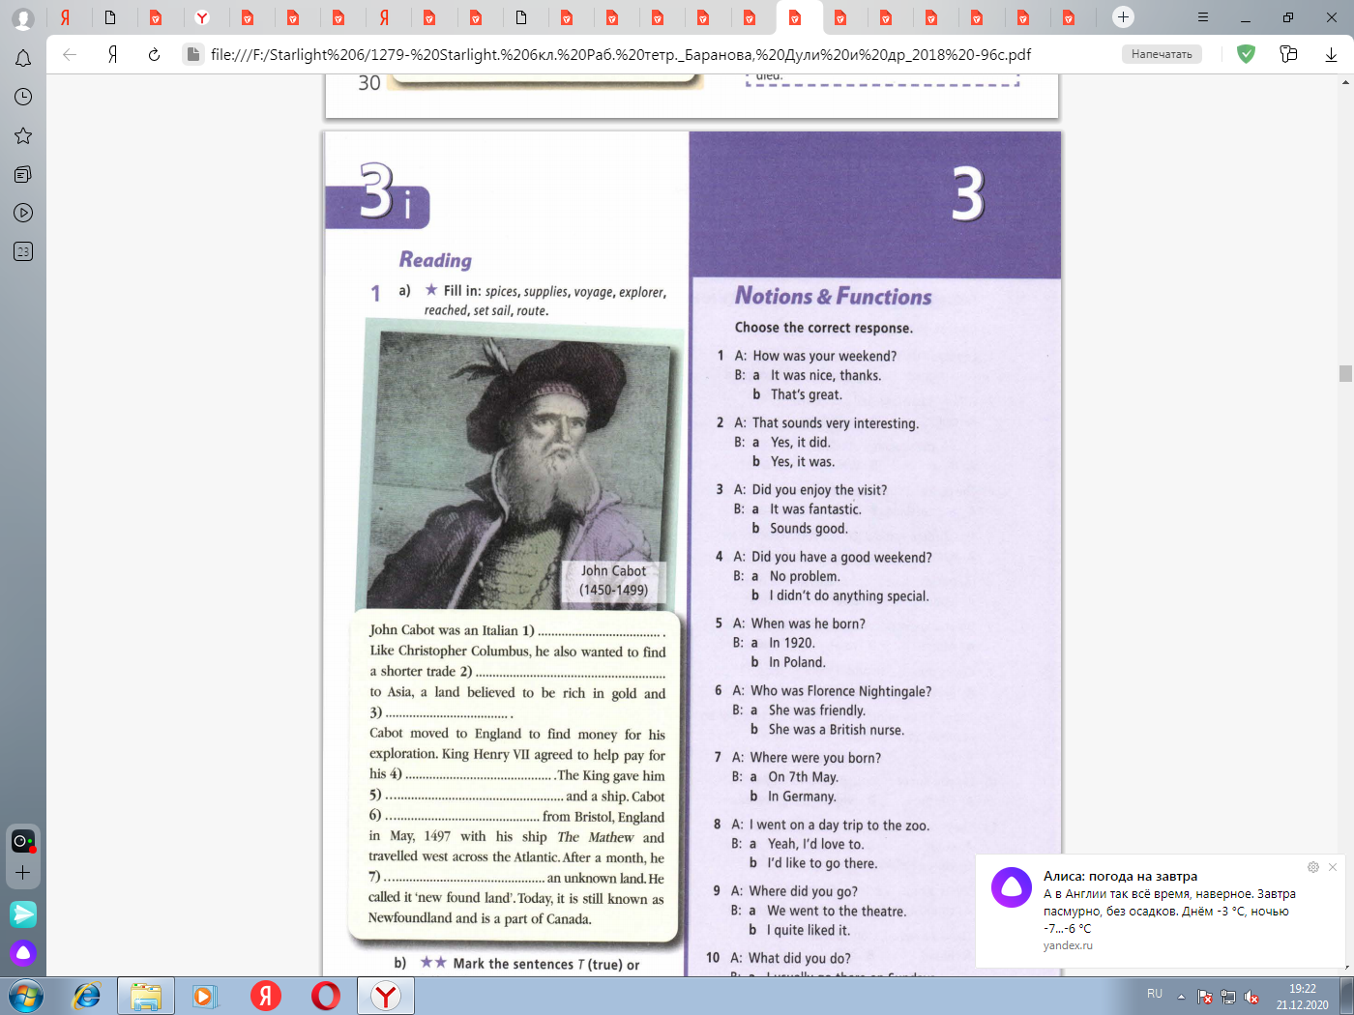
explorer
route
spices
voyage
supplies
set sail
reached

Slide 3
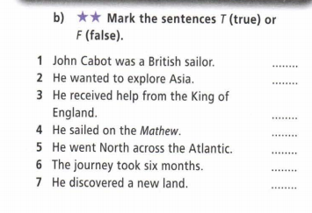
F
T
T
T
F
F
T

Slide 4
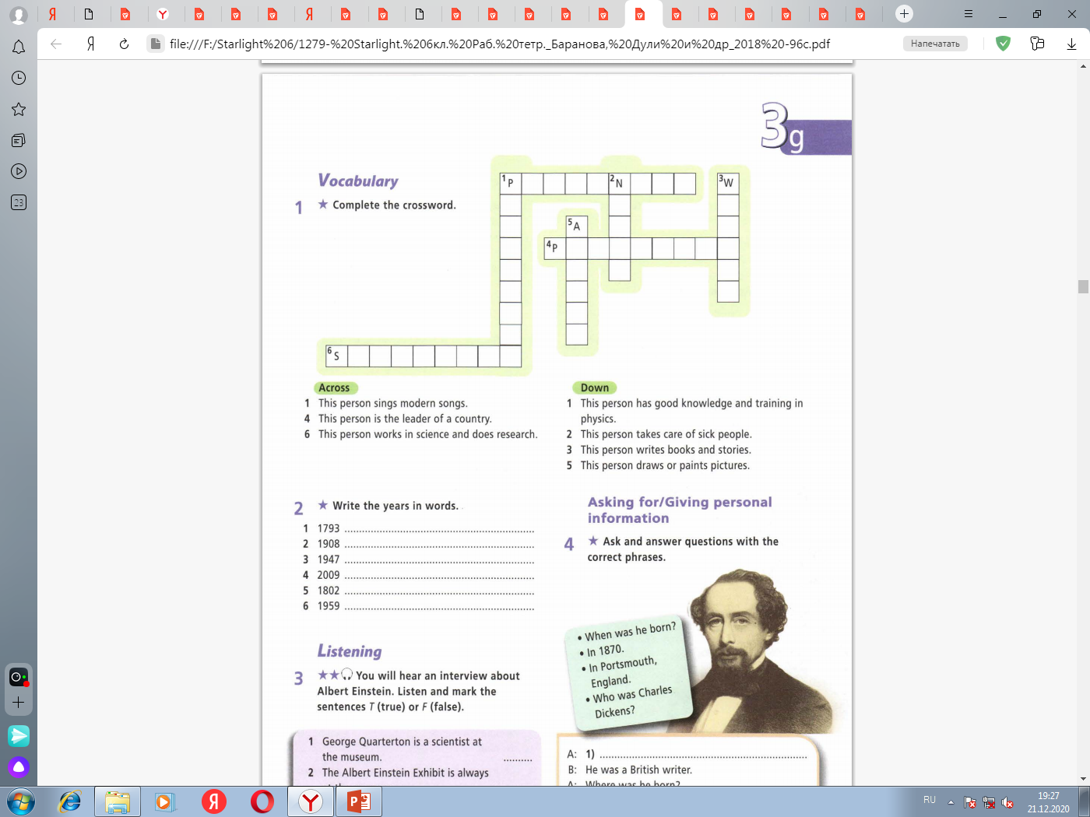
O P S I G E R
H
U
R
Y
R
I
S
R E S I D E N T
I
T
E
E
C
I
R
I
S
S
T
C I E N T I S T

Slide 6
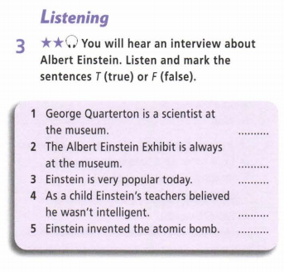

F
F
T
T
F

